Slide 1
Lewes History Group
10 September 2012
Back to Front
Toronto Terrace in 2012
by Jane Lee

Slide 2
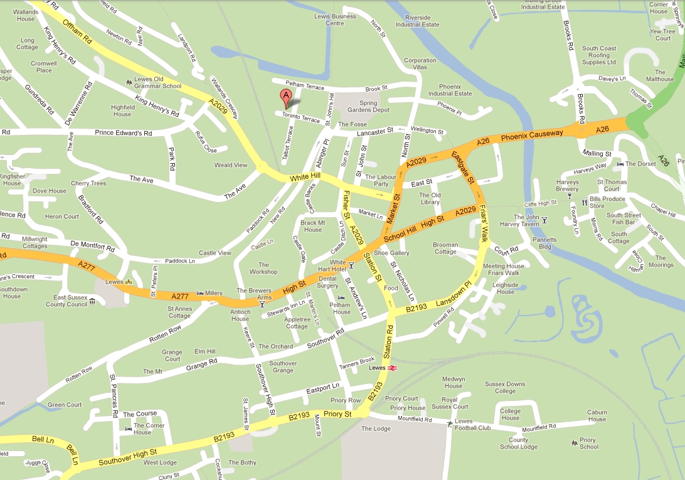
Toronto Terrace, Lewes

Slide 3
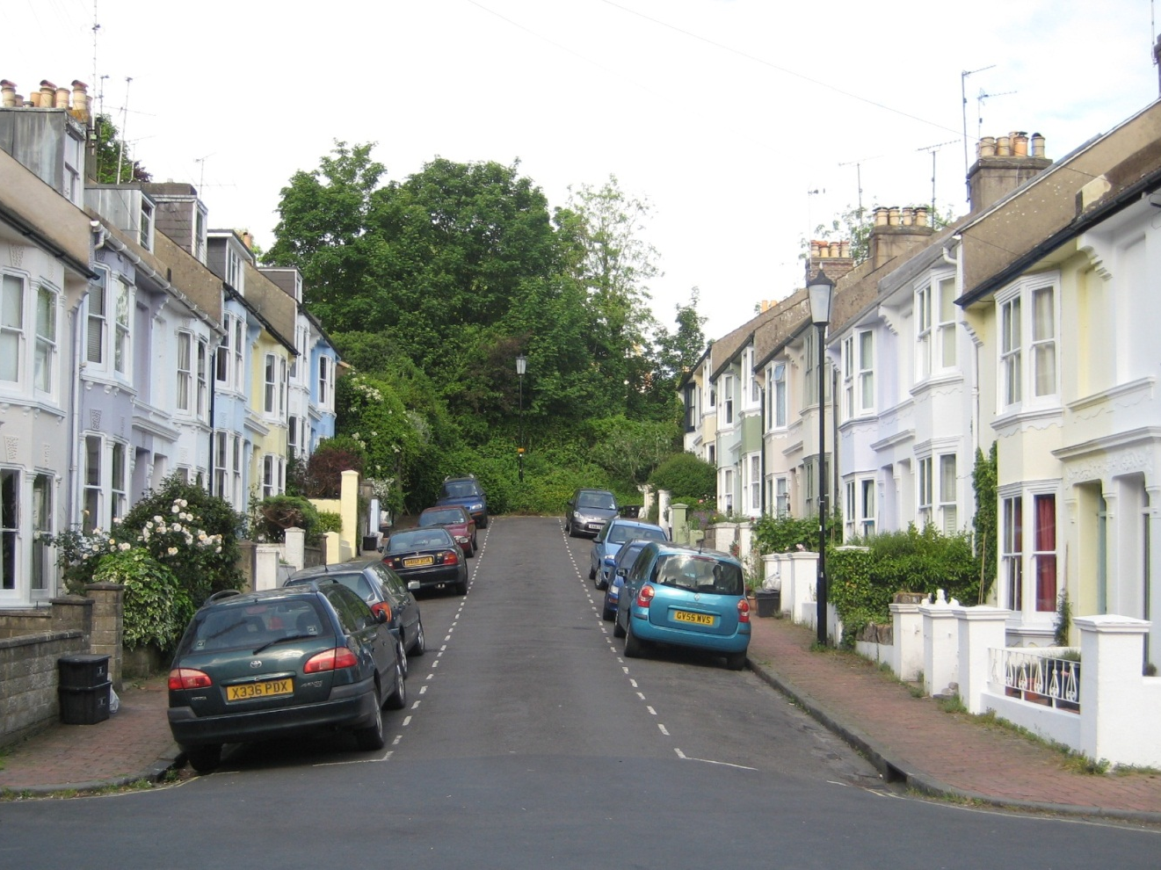
Toronto Terrace, Lewes in Summer 2012
Photo taken by Jane Lee, 2012
Notes:
Focus on houses 1 – 18 in the cul de sac
Reason for starting the project – to leave a visual record for future historians

Slide 4
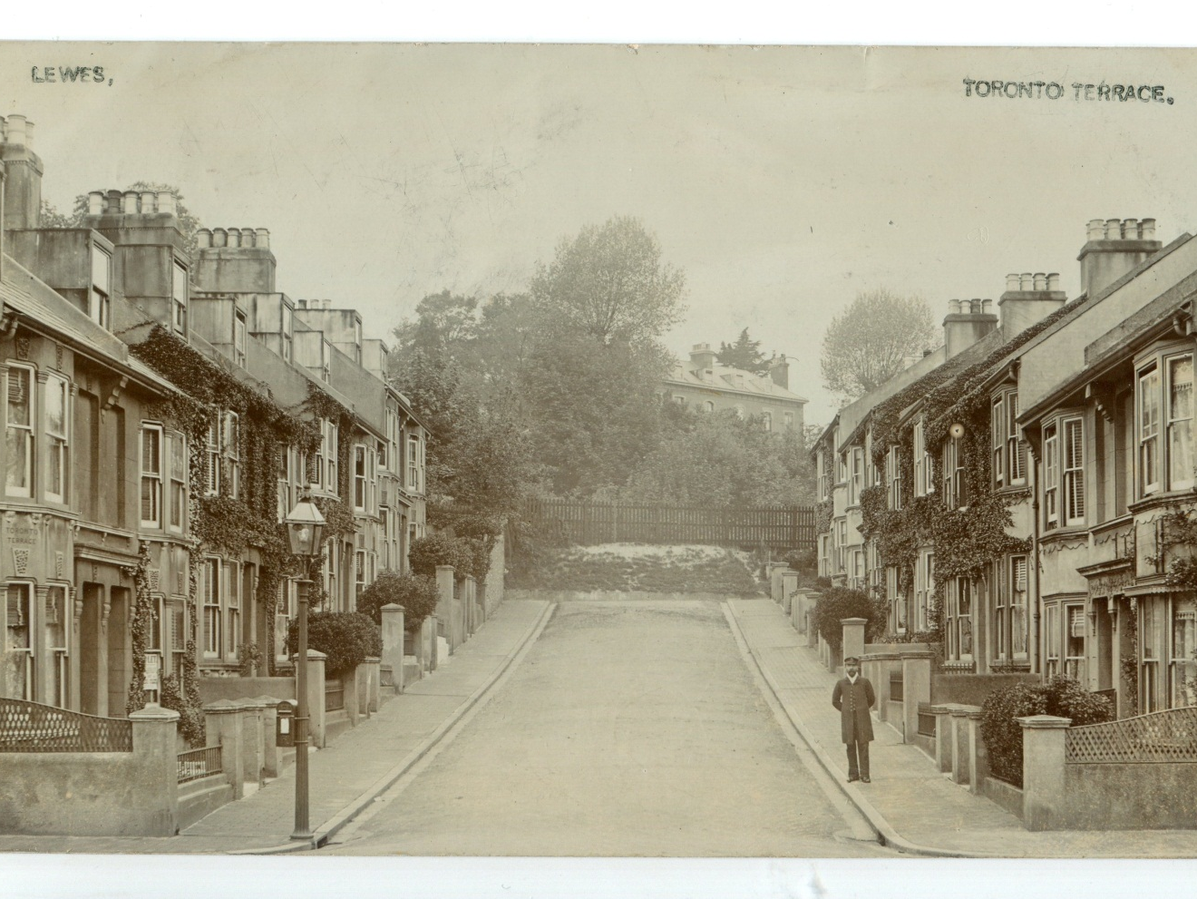
Toronto Terrace by James Cheetham in 1907
John Ready outside his house at #13
From Bob Cairns’ collection
Notes:
When was this published?
Does someone have the postcard so I can scan an original?

Slide 5
Toronto Terrace – Some Facts
In St John sub Castro parish (Pells area)
Built on Lewes Cattle Market Company’s land
1883 23 plots in Pelham & Toronto Terrace sold off
Planning permission for new streets (Toronto, Talbot, Pelham & St John’s Terraces) granted 1 Aug 1883
#1-8 built c.1882
#9-18 built c. 1892

Slide 6
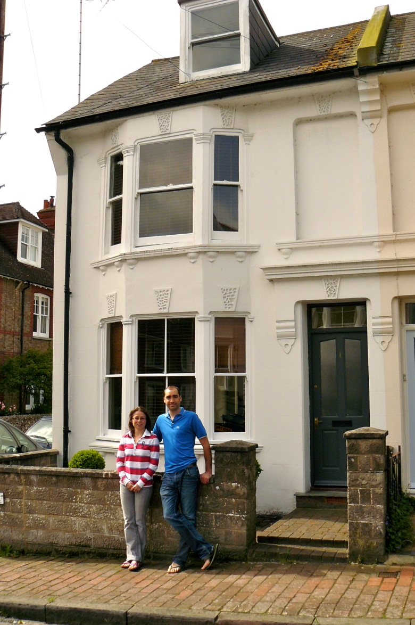
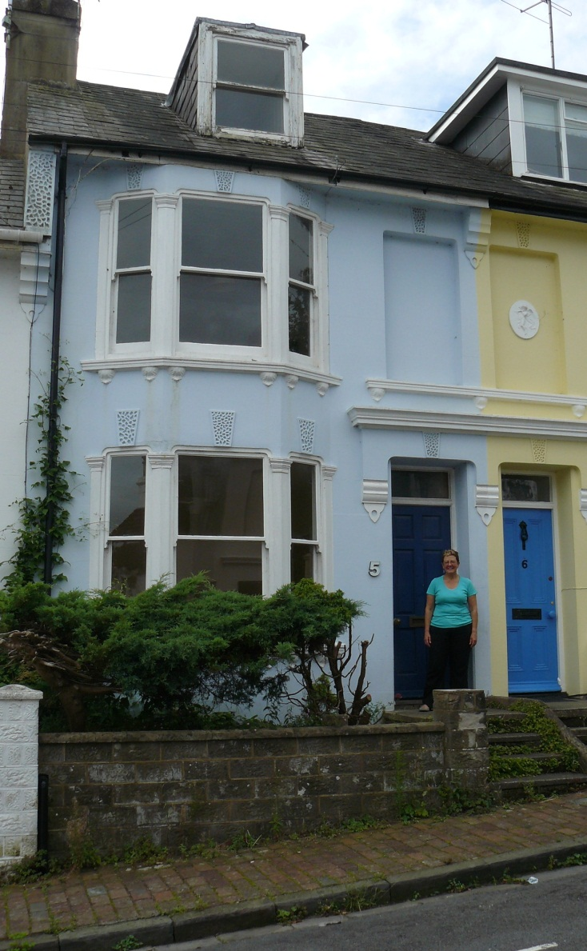
#1 & 5 - Newest residents: May & July 2012
Photos taken by Jane Lee 2012
Notes:
This year #1 &#5 have changed hands
#1 Charlotte Gould & James Chubb
#5 Ros Brewer

Slide 7
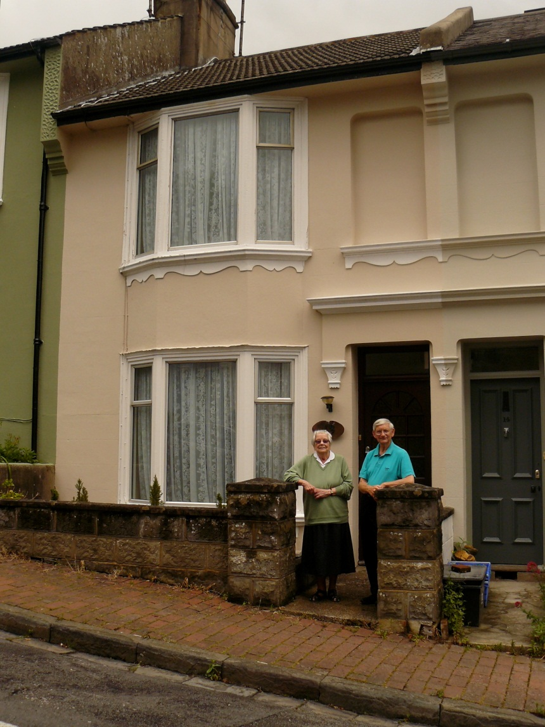
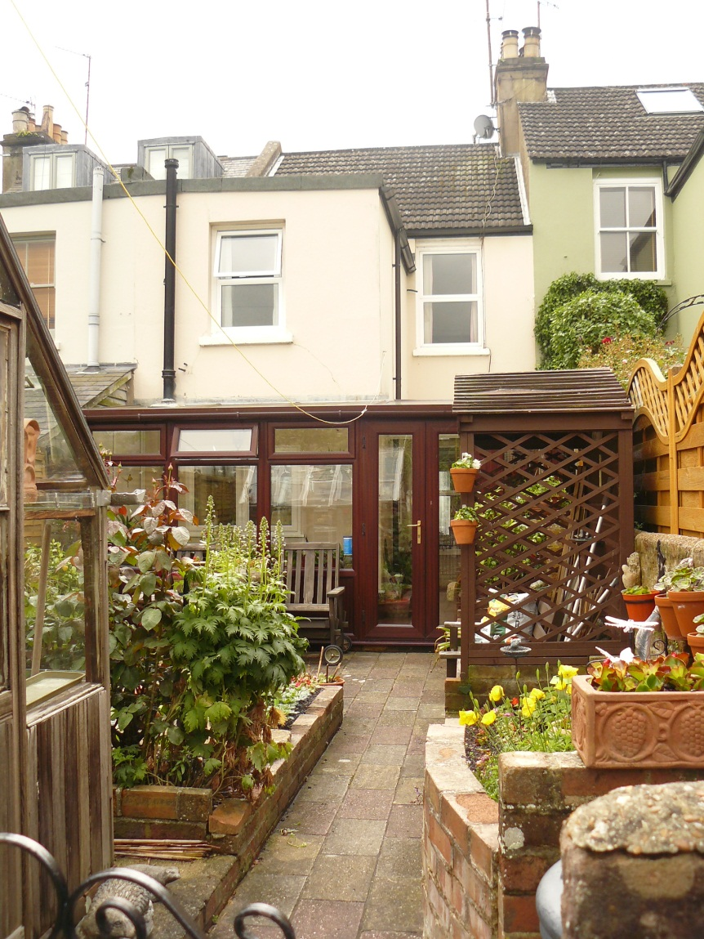
#13 - Oldest residents: April 1956
Photos taken by Jane Lee 2012
Notes:
Maurice & Pat Piper

Slide 8
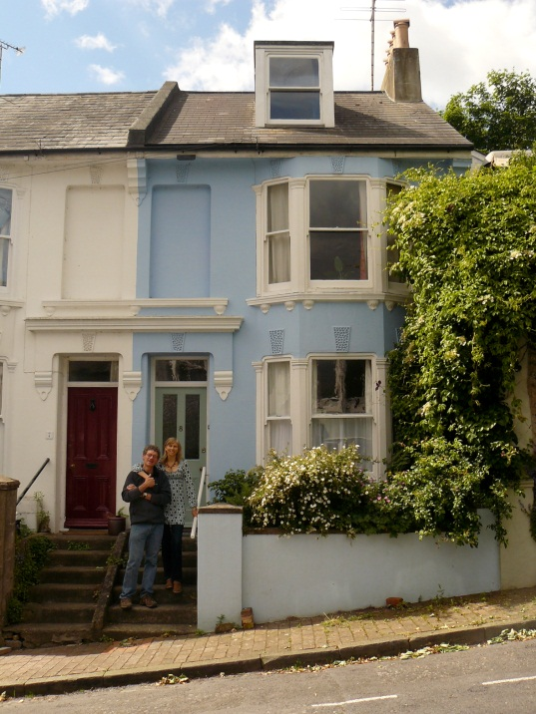
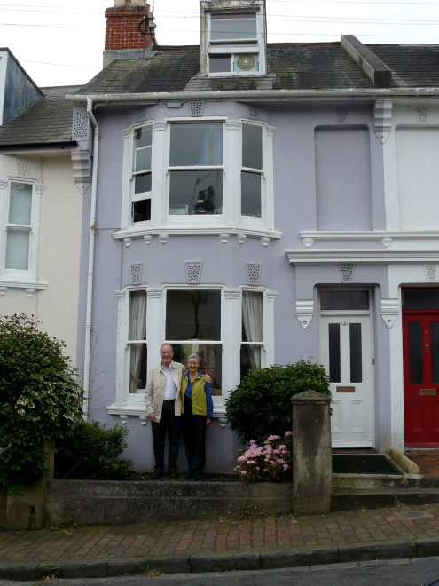
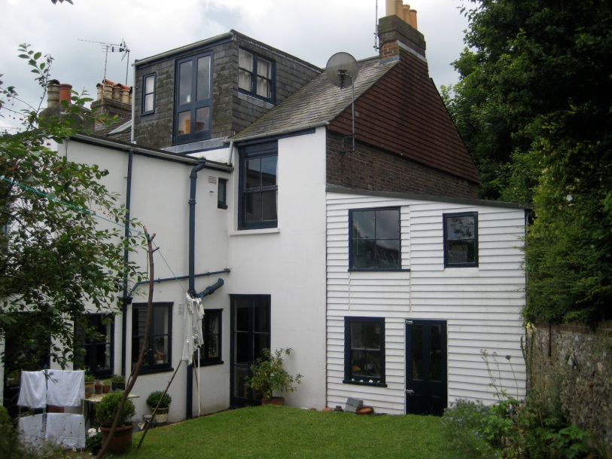
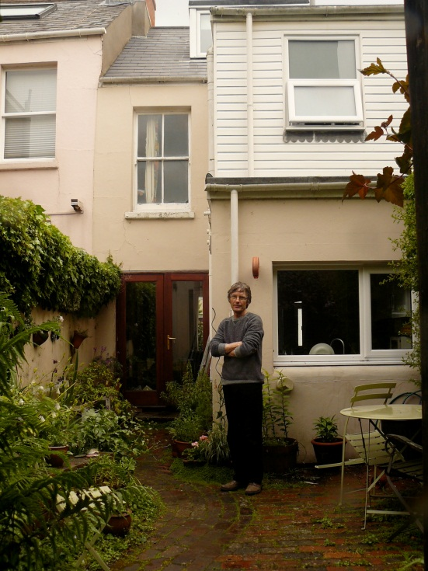
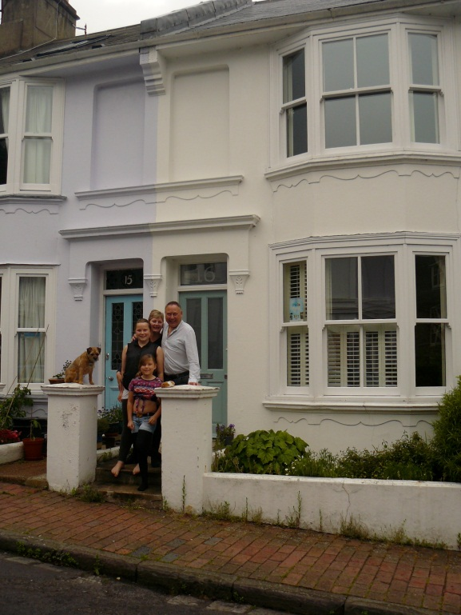
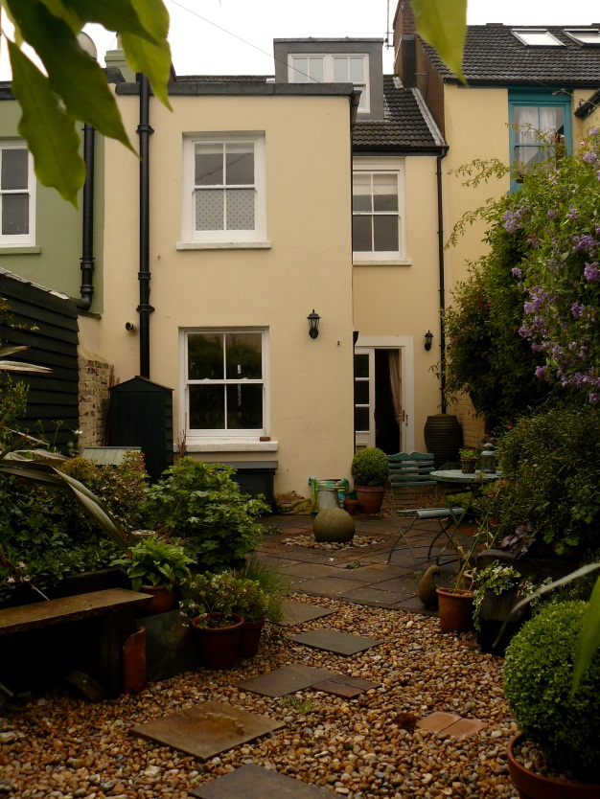
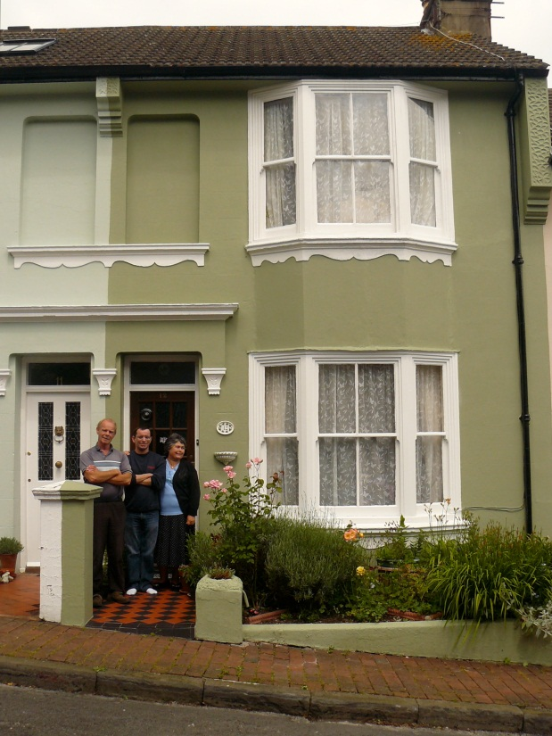
#8
#3
#9
#2
Photos by Jane Lee 2012
#11
#16
#12

Slide 9
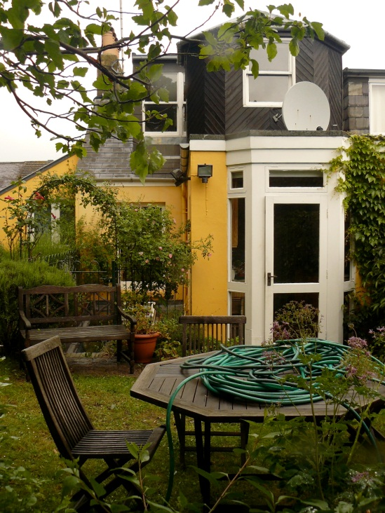
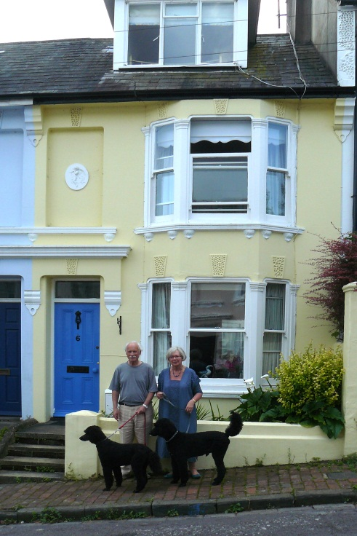
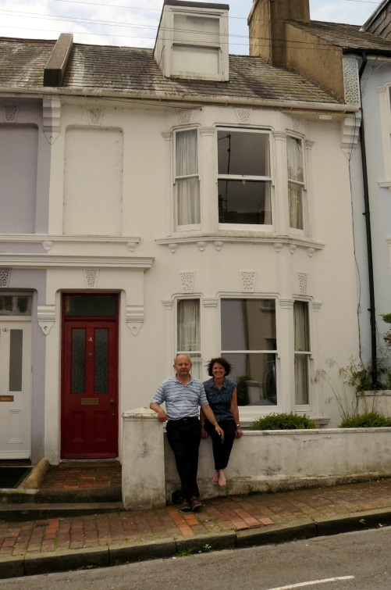
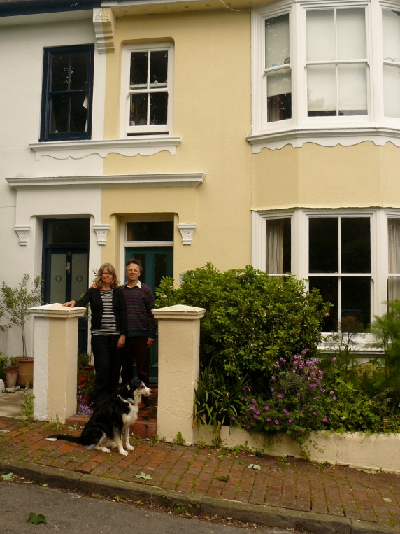
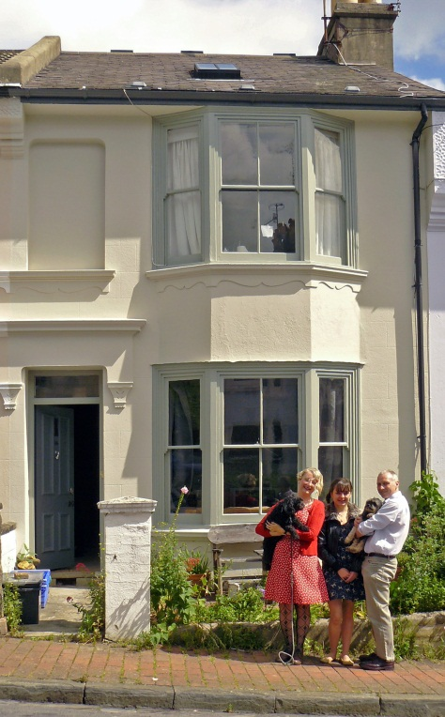
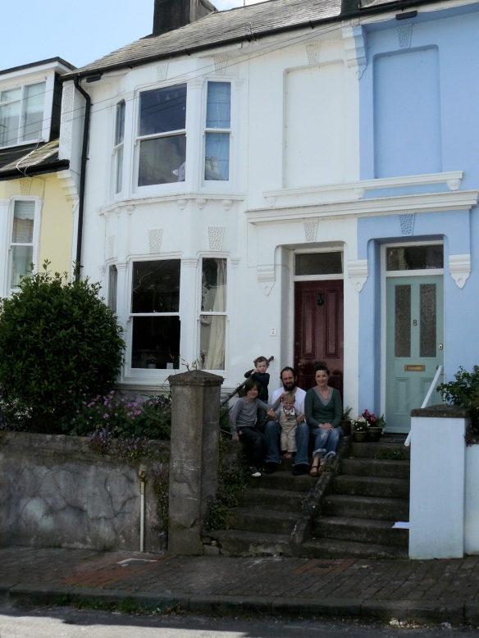
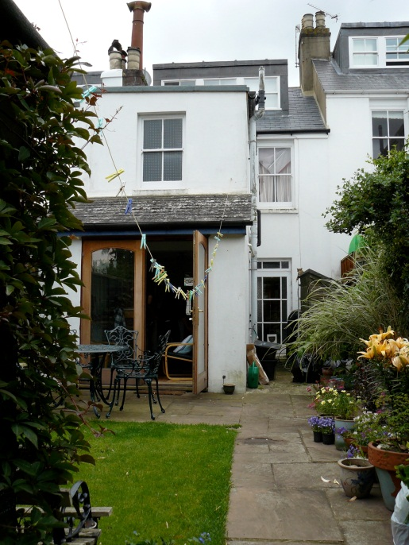
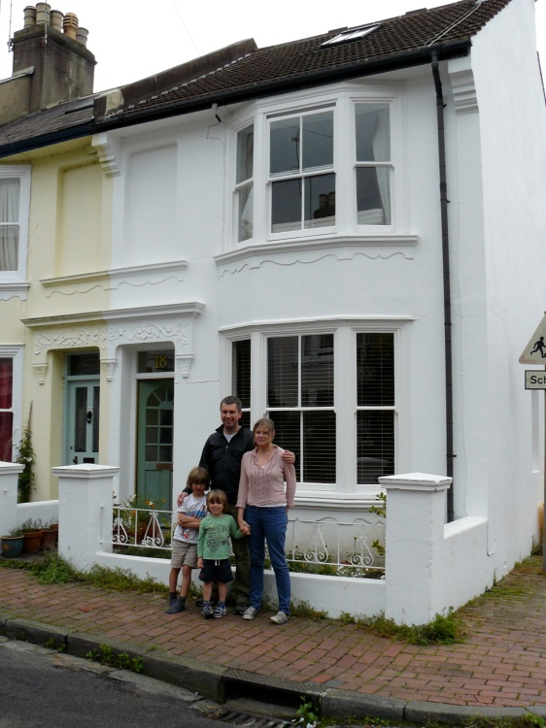
#4
#6
#10
#8
#17
#14
#7
#18
Photos by Jane Lee 2012

Slide 10
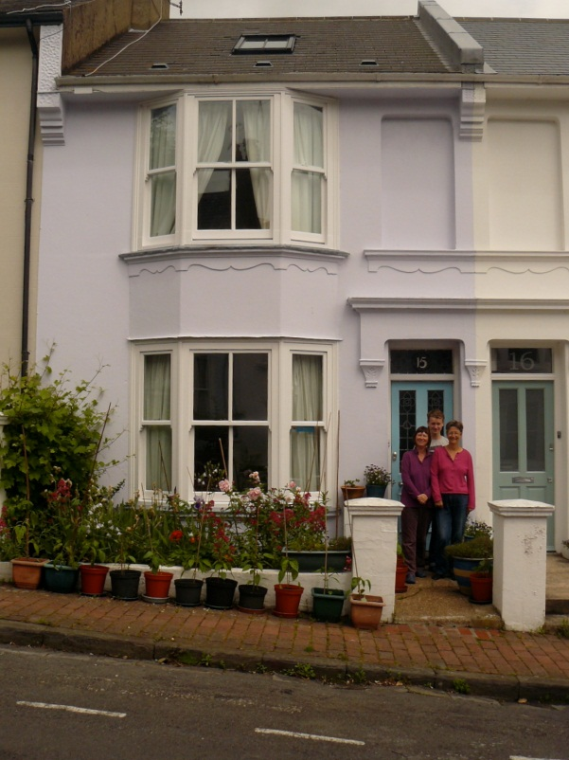
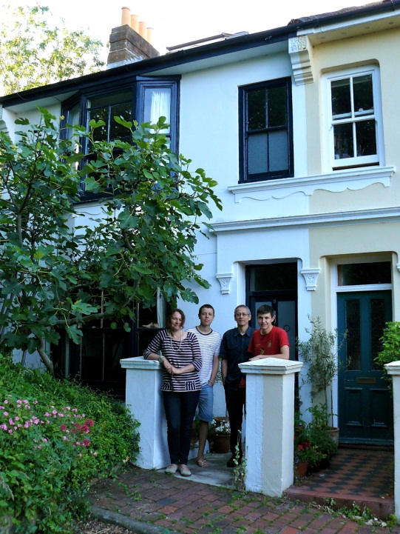
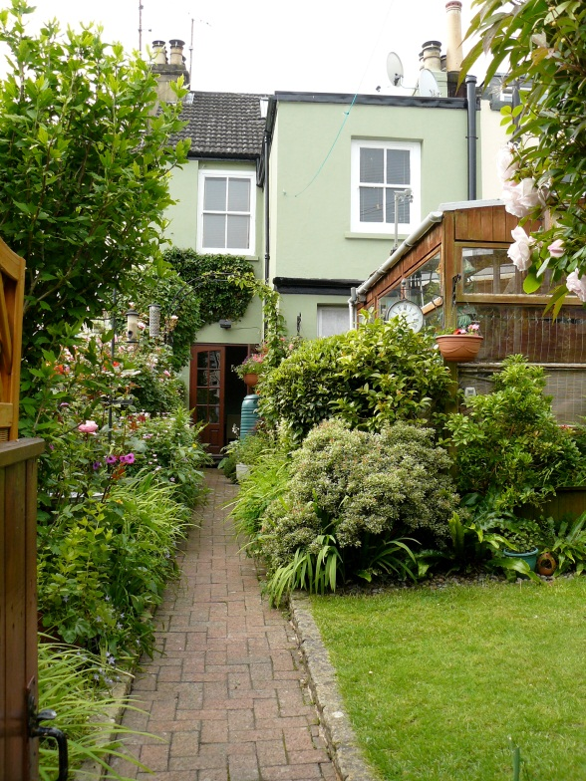
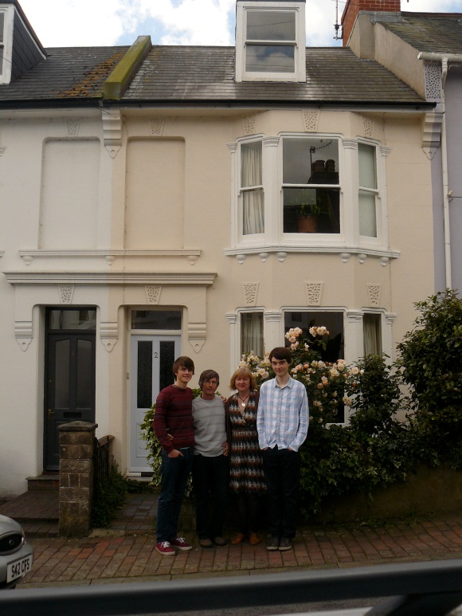
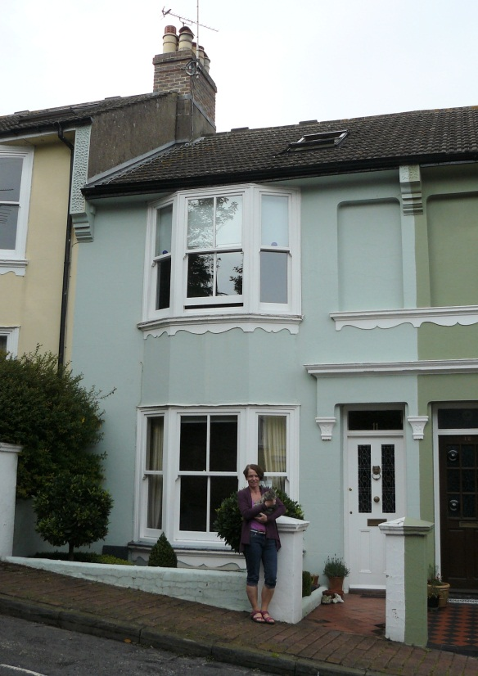
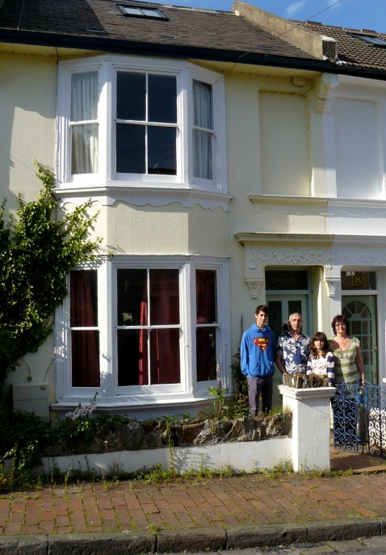
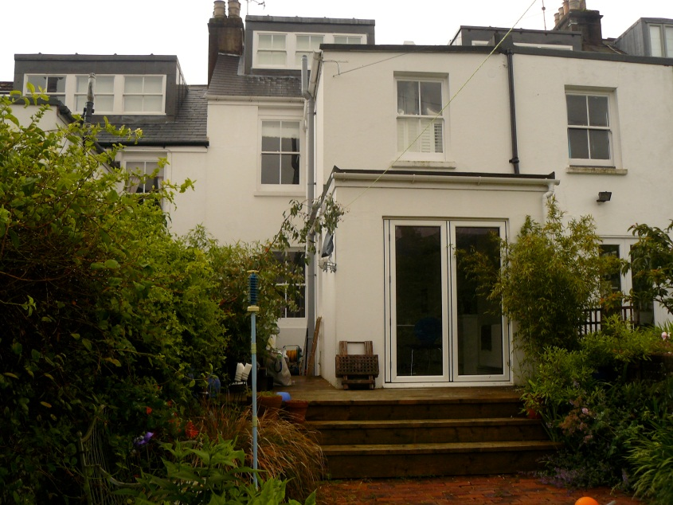
#9
#15
#2
#10
#16
#17
Photos by Jane Lee 2012
#11

Slide 11
What next?
Notes:
Who lived in each house…
Started looking at deeds

Slide 12
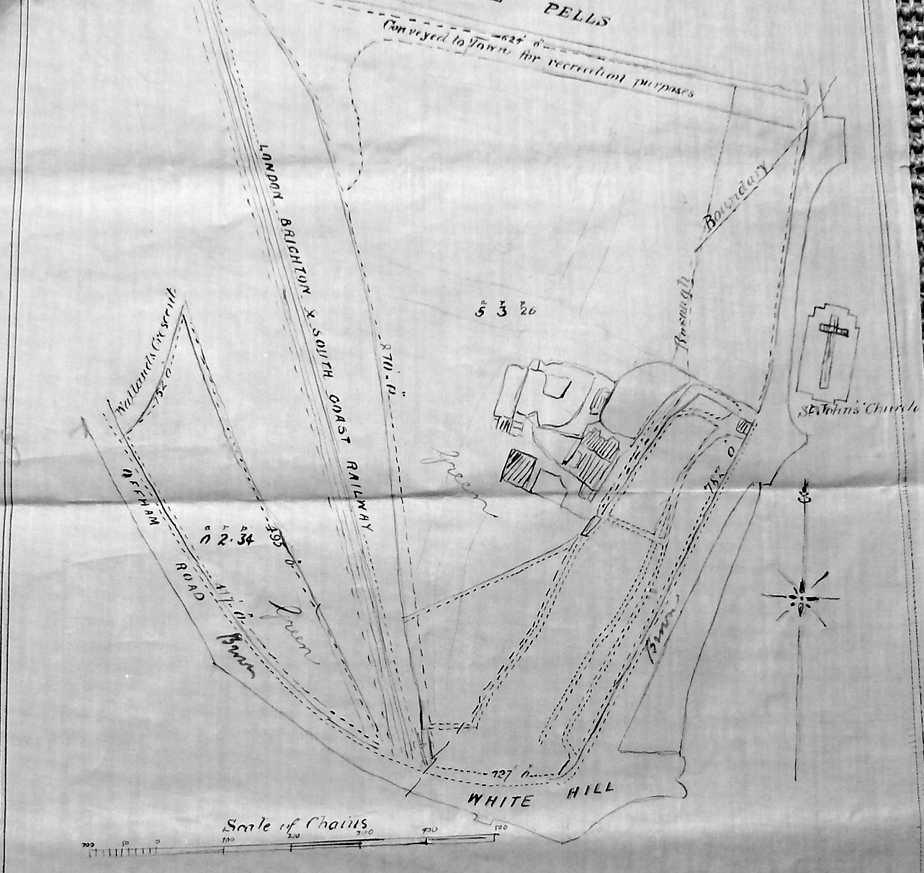
St John’s Farm: Land sold 15 December 1878 by Anne D’Albiac to Lewes Cattle Market Company
Source: Deeds of 12 Toronto Terrace
Notes:
This plan came from abstract of title with #12’s deeds – show doc
Need help in understanding the abstract of title & a set of mortgage docs

Slide 13
Toronto Terrace
Residents’ occupations include
  Horseracing people (trainers, jockey, blacksmith)
  Retired seaman
  Bicycle mechanic
  Spinsters & gentleman
  Iron foundry worker
  Master bricklayer
  Printer operator
  Property developer
  School attendance officer
  Pumping station mechanic
  Scale maker
  Fireman
Notes:
Used deeds to start building a record of past residents.

Slide 14
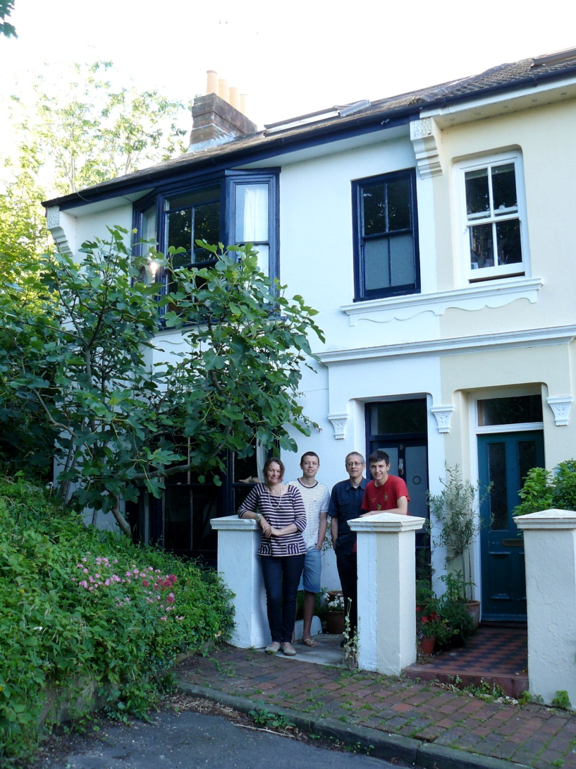
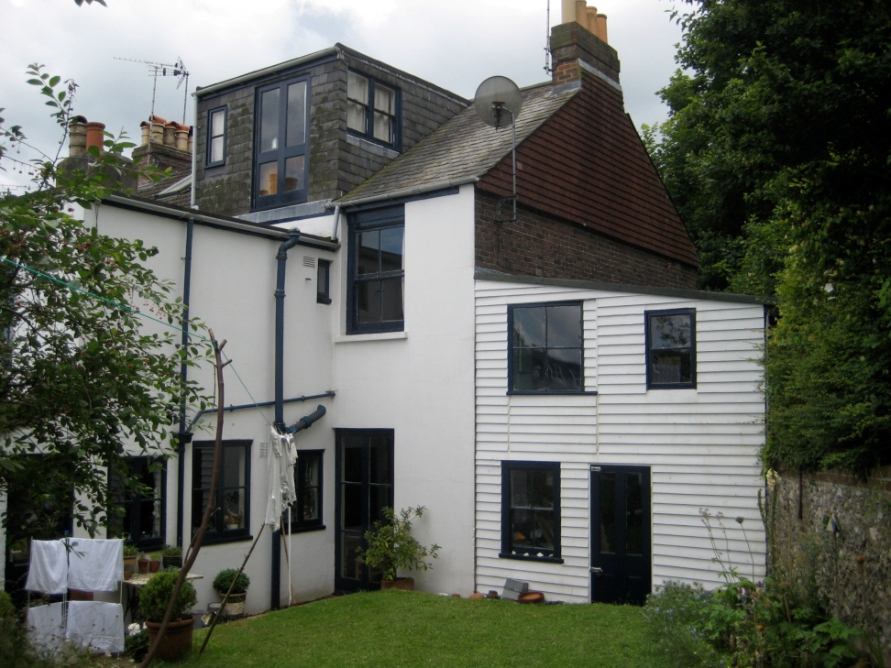
9 Toronto Terrace
Photos by Jane Lee 2012

Slide 15
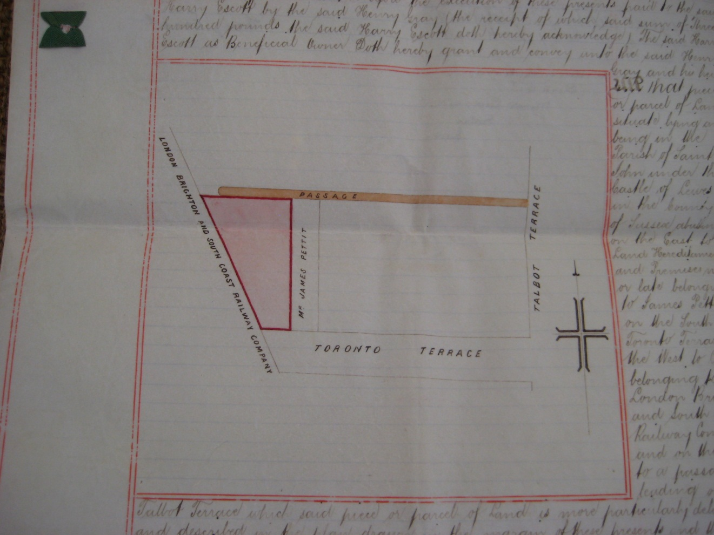
Extract from deeds of 9 Toronto Terrace July 1895
Henry Escott, [?racehourse] trainer sold to Henry Gray, jockey for £300. Gray had already rented the house for up to 14 months prior

Slide 16
9 Toronto Terrace - Occupants
Planning granted to A Kemp & JW James (builder) 4 Feb 1891. Built by Edward Hammond, 9 Pelham Terr.
May 1892 - 1894 Henry Prince sold plot to Arthur Kemp junior for £36
1894 – 95: Harry Escott (trainer) paid £285. He probably let it
1895 – 1916: Henry Gray (jockey/private in Ryl Vet Corps) paid £300 (was a tenant)
1916 – 36: Mrs Annie Reegan (wife to George Reegan, blacksmith) paid £300 (prob’ly let it out)
1936 - 88: Mrs Dorothy Barber (rented from Annie Reegan) paid £400
1988 – 98: Conrad & Helene Adamczewski
1998: John da Silva & Bekki Doy + Luis & Isaac

Slide 17
What to do with the photo project
Offer images to ESRO
Publish on local studies sites – suggestions?
Exhibit in Artwave 2013
Anything else?

Slide 18
Further research
Continuing research of occupancy of each house – deeds, planning applications, censuses, directories, electoral registers
Oral interviews with longest standing residents
Extending project to rest of Toronto Terrace &/or other roads in Pells/St Johns’ area

Slide 19
Help Needed
Research sources advice
Any Toronto Terrace deeds
Past images of the street/area
Contact Jane on dexteritypr@gmail.com
01273 487617

